Slide 1
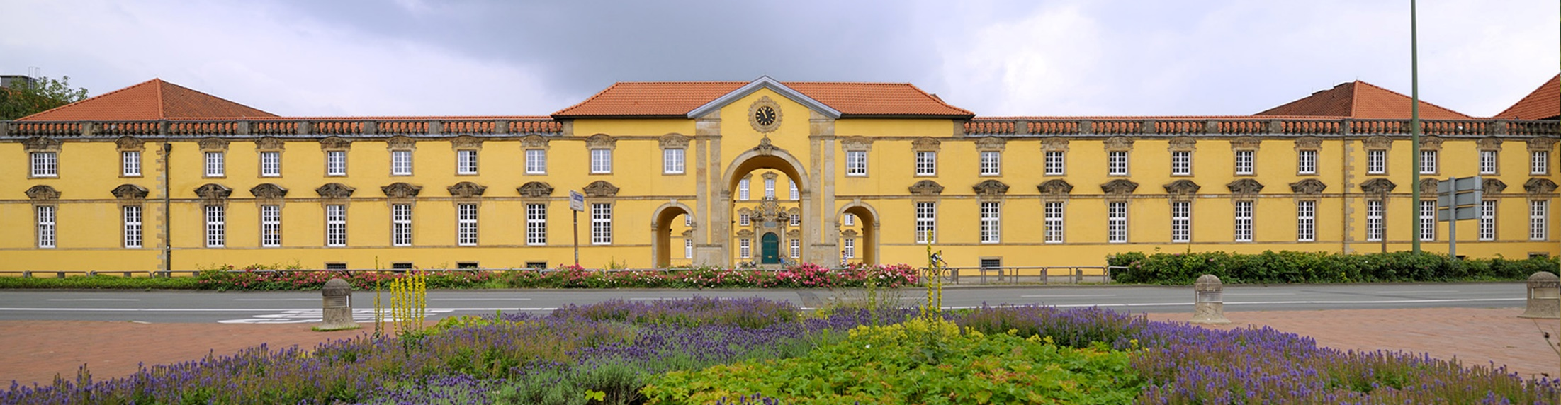
Conference: European Agricultural Data Governance
Smart Agricultural Machinery
Contract Design & General Terms and Conditions
Prof. Dr. Mary-Rose McGuire/Prof. Dr. Hans Schulte-Nölke
European Legal Studies Institute, Universität Osnabrück
Freiburg, 06.12.2024

Slide 2
Overview
  I. Introduction: Why MCT for agricultural machinery?
  II. Data Networks: Specifics of the agricultural sector
  III. Data Chains: Change of user and multiple users
  IV. Policing of Contract Terms by Courts and Authorities
  V. Way forward: The AgriData-Observatory
Freiburg, 06.12.2024

Slide 3



I. Introduction
Why model contract terms for agricultural machinery?
Data Act:
Requires contracts to be concluded between parties involved in the data chain
Data Recipient
Data Holder
User
Freiburg, 06.12.2024

Slide 4

I. Introduction
Why model contract terms for agricultural machinery?
Data Act:
Requires contracts to be concluded between parties involved in the data chain
Data Recipient
Data Holder
User
Freiburg, 06.12.2024

Slide 5
I. Introduction
Why model contract terms for agricultural machinery?
Data Act:
Requires contracts to be concluded between parties involved in the data chain
Data Recipient
Data Holder
User
Freiburg, 06.12.2024

Slide 6




I. Introduction
Why model contract terms for agricultural machinery?
Background: Agricultural research projects involving the Osnabrück Research Unit Law and Data Economy, including
AgroNordwest Experimentation Field
AgriGaia
5G Agrar
Data Holder
User
Freiburg, 06.12.2024

Slide 7
I. Introduction
Why model contract terms for agricultural machinery?
  From about 2010
  Oct 2019
  Feb 2022
  March/Sept 2023
  Dec 2023
  Oct 2024
  Nov/Dec 2024
  Dec 2024
  Chronology
  Agricultural research projects on Smart Farming (involvement of Osnabrück Research Unit Law and Data Economy since 2019)
  Competence Network ‘Digitalisation in Agriculture’ founded by Federal Ministry of Food and Agriculture (BMEL)
  COM Proposal for the Data Act
  Workshops on Contracts for Agricultural Data (Osnabrück/BMEL)
  Publication of the Data Act in the Official Journal
  Publication of BMEL-Model Terms and Conditions for Contracts on Agricultural Data from Smart Farming Machinery
  Series of COM webinars: Drafts of COM MCTs disclosed
  Freiburg European Agricultural Data Governance 🙂
Freiburg, 06.12.2024

Slide 8
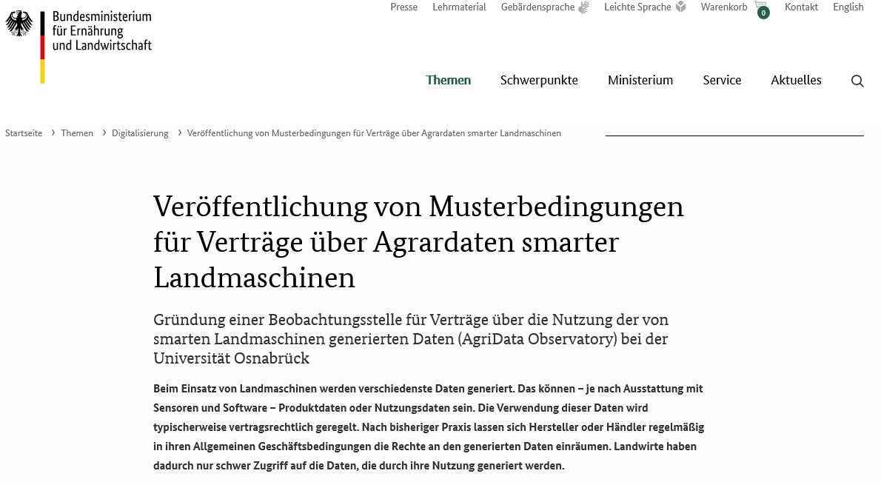
I. Introduction
Why model contract terms for agricultural machinery?
Translation:
Publication of model terms and conditions for contracts for agricultural data from smart agricultural machinery
Establishment of an Observatory for contracts on the use of data generated by smart agricultural machinery (AgriData Observatory) at the University of Osnabrück
Source: https://www.bmel.de/DE/themen/digitalisierung/musterbedingungen-vertraege-agrardaten.html
Freiburg, 06.12.2024

Slide 9
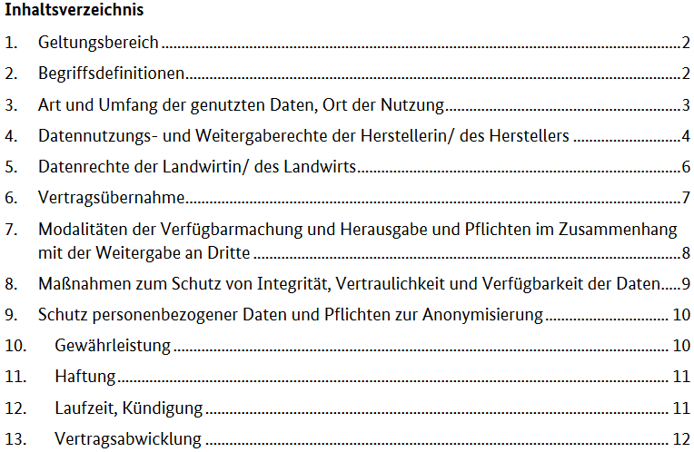
I. Introduction
Why model contract terms for agricultural machinery?
Translation
Scope of application
Definitions
Type and scope of the data used, place of use
Rights of the manufacturer to use and transfer data
Data rights of the farmer
Assignment of contract
Modalities of availability and surrendering and obligations in connection with disclosure to third parties
Measures to protect the integrity, confidentiality and availability of data
Protection of personal data and anonymization obligations
…
Source: https://www.bmel.de/SharedDocs/Downloads/DE/_Digitalisierung/musterbedingungen-digital-landmaschinen.html
Freiburg, 06.12.2024

Slide 10







II. Data Network
Data Flow
Research Institute
(Data recipient)
Data transfer
Data holder
(Softwareprovider)
Farmer
(User)
Manufacturer
(Data holder)
Lessor (Further User)
Freiburg, 06.12.2024

Slide 11

II. Data Network
3 Obvious Differences
  Dual Use: Fulfilling agricultural tasks (sowing, mowing) and in gathering useful product data, agricultural data and usage related data.
  Long-term: Agricultural machinery is an investment often accompanied by an ongoing contractual relationship (connected service)
  Multiple Persons: Devices are may be used by several different persons, simultaneously or successively
Freiburg, 06.12.2024

Slide 12




II. Data Network
The Simplified Model
Research Institute
(Data recipient)
CHAPTER II
BUSINESS TO CONSUMER AND BUSINESS TO BUSINESS DATA SHARING
Art. 3 (1) DA
Connected products shall be designed and manufactured … in such a manner that product data … are … directly accessible to the user.
Art. 3 (2) DA
Before concluding a contract … the seller … shall provide … the following information to the user
Art. 4 (13) DA
A data holder shall only use any readily available data that is non-personal data on the basis of a contract with the user.
Data holder
(Softwareprovider)
Farmer
(User)
Manufacturer
(Data holder)
Data transfer
Contracts DA
Lessor (User)
Freiburg, 06.12.2024

Slide 13




II. Data Network
The BLE Model Clauses
Data transfer
Contracts DA
BLE Model Clauses
Data holder
(Softwareprovider)
Farmer
(User)
Manufacturer
(Data holder)
Lessor (Further User)
Lessor (User)
Freiburg, 06.12.2024

Slide 14

III. Data Chains
Multiple Users
7.2. Multiple Users
Where the Initial User grants a right to use of the Product and/or Related Service(s) to another party while retaining their quality as a user (‘Additional User’), the Parties undertake to comply with the requirements set out in this clause …
… provisions substantially reflecting the content of this agreement …
BLE Model Clauses
Further Proposal
Farmer
(User)
Manufacturer
(Data holder)
Lessor (User)
Freiburg, 06.12.2024

Slide 15
III. Data Chains
A Comparison between Data Use and IP License Contracts
  Second level contracts are the rule:
    Transfer: new user must either step into the former user’s shoes or conclude a new contract.
    Lease: lease contract must manage if and to which extent the new user gets access and is entitled to use the data
  National contract laws share the weakness
  of the Data Act
  IP law’s expertise in managing contract chains
    rights and obligations of multiple actors
    specify the scope of such permission, including limitations on territorial scope, duration, and purpose of usage
  So called “data license contracts”
  ☑ Building on IP contract law
Freiburg, 06.12.2024

Slide 16

III. Data Chains
3 Different Solutions
BLE Model Clauses
Working Translation
6. Assumption of contract
6.2. By concluding this agreement, the manufacturer agrees in advance to the assumption of the contract by the second (or further) buyer of the machine. The reseller is obliged to inform the manufacturer of the contractual partner and the time of the assumption of the contract.
1. Transfer + New Contract
2. Transfer + Assignment of Contract
3. Lease + Additional Data Use Contract
Data Use Contract 1
Data Use Contract 2
Data User 1
Data User 2
Data Use Contract 1
Assignment
Data Use Contract 1+
Continuous data use
Continuous data use
„sub-licence“
„sub-licence“
„sub-licence“
Data User A
Data User B
Data User C
Freiburg, 06.12.2024
Notes:
c) Three Different Solutions
Yet, IP-law also teaches us, that despite the many different constellations with a view to the design of contractual relationships it is sufficient to distinguish three different types, which may serve as building blocks for more complex constellations.

Slide 17
III. Data Chains
Requirements and Anchor Points in the First Level Contract
BLE Model Clauses
Working Translation
6. Assumption of contract
6.2. By concluding this agreement, the manufacturer agrees in advance to the assumption of the contract by the second (or further) buyer of the machine. The reseller is obliged to inform the manufacturer of the contractual partner and the time of the assumption of the contract.
Potential Adaptation
1. Scope of Application
6a. Sub-Contracts
  Assignment of Contract
  The manufacturer in advance accepts an assignment of the contract.
  The manufacturer is obliged to offer a potential further user of the machinery a service contract on comparable terms.
  The first user is obliged to inform the data holder whether he permits the further use of previously generated data
  All parties are bound by a confidentiality duty.
  Data Use Sub-Contract
  The manufacturer in advance accepts a grant of a further use right subject to the similar conditions.
  The first user is obliged to inform the data holder of the second user in case he grants a right of use
Freiburg, 06.12.2024
Notes:
c) Requirements and Anchor Points in the First Level Contract
At the point of time of the first sale of the machinery both parties may not yet know how the further lifecycle of the machinery will develop. It is hard to predict whether there will be further users and if so, whether they acquire the rights of use by virtue of a sale, a lease or otherwise. This uncertainty in unavoidable. To ensure that this factual uncertainty is not trailed by legal uncertainty, both parties share the common interest to safeguard that all future contracts are consistent with the first. Accordingly, a well drafted first level contract should provide for respective rights and duties. In essence, they should envisage a possible further user:
The first user is obliged to inform the manucfacturer/data holder in case he grants a right of use (transfer or lease) to a third party
The first user is obliged to inform the manucfacturer/data holder whether he permits the further use of previously generated data
The manufacturer is obliged to accept an assignment of the contract, unless he has justified concerns to enter into a contract with that specific third party.
The manufacturer is obliged to offer a potential further user of the machinery a service contract on comparable terms, unless he has justified concerns to enter into a contract with that specific third party.
All parties are bound by a confidentiality duty.
For obvious reasons compliance with these clauses should be ensured by technical options, in particular access to a user’s account.

Slide 18
IV. Policing of
Contract Terms
Policing of terms in data use contracts
Under the Data Act, Art. 13 [and Art. 7 (2), Art. 12 (2)]
Under the applicable national law (e.g. German law)
  Policing of standard terms, e.g. §§ 305 et seq. BGB [insofar applicable!]
  General rules on formation and validity of contracts, e.g. §§ 134, 138, 145 et seq., 164 et seq. BGB
Freiburg, 06.12.2024

Slide 19
IV. Policing of
Contract Terms
Policing of terms under Art. 13 Data Act – Basic Rule
A contractual term
concerning access to and the use of data or liability and remedies for the breach or the termination of data related obligations,
unilaterally imposed
by an enterprise on another enterprise,
… if it is unfair …
☑ shall not be binding on the enterprise
[which unilaterally imposed it].
  [Applies to contracts concluded after 12 September 202 or to long-term-contracts concluded on or before 12 September 2025]
Freiburg, 06.12.2024

Slide 20
IV. Policing of
Contract Terms
Many Questions on Art. 13 Data Act
Priority of application [Anwendungsvorrang] of Art. 13 Data Act over conflicting provisions of national law?
Or: Only minimum requirements where a policing of standard terms is applicable under national law such as §§ 305 et seq. BGB [which, however, differ in their scope of application from Art. 13 Data Act!]?
‘External gaps’ in the Data Act (= to be closed by the applicable national law) for the assessment of whether a contract has been concluded and is valid (e.g. dissent, error, representation, immorality, transparency of terms)?
☑ Bans on and validity of terms are also and to a large
extent governed by the applicable national law!
[irrespective of the question of priority of application of
Art. 13 Data Act]
Freiburg, 06.12.2024

Slide 21
IV . Policing of
Contract Terms
Policing of Model contractual terms (MCTs)?
Recital (62) Data Act:
“… non-binding model contractual terms for business-to-business data sharing contracts to be developed and recommended by the Commission may also be helpful to commercial parties when negotiating contracts. “
Commission MCT in the sense of Art. 41 Data Act
MCT of the German BMEL for use between agricultural machinery manufacturers and end user
Possible other MCTs
Consequences of the use of MCTs for judicial fairness control and administrative enforcement:
Judicial decisions in individual legal disputes
Judicial decisions in actions brought by an association against the use of certain terms
Administrative decisions
Example from German Law: §310 (1) 3rd sentence BGB regarding the VOB/B (= Contract rules for construction work)
Freiburg, 06.12.2024

Slide 22
IV . Policing of
Contract Terms
Preliminary conclusions for drafting data use contracts
Use of MCTs reduces the risk of judicial invalidation or cease and desist orders, as well as of administrative sanctions
MCTs should take into account the COM’s model and be aligned with the applicable national law [and usually stipulate the applicable by a choice of law clause]!
Freiburg, 06.12.2024

Slide 23
V. Way Forward
The AgriData-Observatory
Funded by Federal Ministry of Food and Agriculture (BMEL)
Purposes of the project
  Establishment of an observatory for contracts for the use of data generated by smart agricultural machinery
  Disseminating of knowledge of the requirements of the Data Act for such machinery and of the BMEL & COM MCTs
  Assessment of legal conformity of data flows
  Identification of best practices / proposals for the use and refinement of the BMEL MCT
Researchers: Annica Ahmann & Leo Kohz;
Project Leaders: Prof. Mary-Rose McGuire & Hans Schulte-Nölke
Project term: October 2024 to September 2027
Project milestones e.g.
  Establishment of an expert and stakeholder group
  Survey / collection of T&Cs used in practice from manufactures, data owners, farmers etc.
  Expert and stakeholder workshops
  Elaboration of proposals for the BMEL MCT
Freiburg, 06.12.2024

Slide 24


V. Way Forward
The AgriData-Observatory
Email:
How can I participate?
Joining the expert and stakeholder group to discuss MCTs
Contributing / disclosing T&Cs used in practice
Any other ideas
Please contact us, by all means, e.g.
Via our website
By email at dataeconomy@uos.de
By approaching those who are present, i.e.
Annica Ahmann, Leo Kohz, Mary-Rose McGuire or
Hans Schulte-Nölke
Freiburg, 06.12.2024

Slide 25
Sources
Antoine, Datenzugang im Spannungsfeld zwischen DSGVO, Geschäftsgeheimnisschutz und Datenbankherstellerrecht: Achillesferse des Data Act in der Praxis?, CR 2024, 73
Czychowski, Shaping the Data Economy: Ausgestaltung von Datenüberlassungsverträgen aus Herstellerperspektive - Welche Gestaltungspielräume lässt der Data Act?, CR 2024, 80
Ehlen/Sebulke, Der Data Act: Zwischen Markt- und Vertragsgestaltung - Auswirkungen auf die Ausgestaltung von Datenüberlassungsverträgen aus der Perspektive von Nutzern, CR 2024, 84
Grützmacher, Data Act: Datenzugang und Geschäftsgeheimnisschutz - Zwei Antipoden und das Ende des Geheimnisses?, CR 2024, 281
Schmidt-Kessel, Heraus- und Weitergabe von IoT-Gerätedaten, MMR 2024, 75
Schwamberger, Die Klauselkontrolle in Art. 13 Data Act, MMR 2024, 96
Steege, Technische Schutzmaßnahmen des Dateninhabers im Data Act, MMR 2024, 91
Westphalen, Der neue Data Act - Eine Kaskade AGB-rechtlicher Verbote im unternehmerischen Verkehr, BB 2024, 515
Freiburg, 06.12.2024

Slide 26
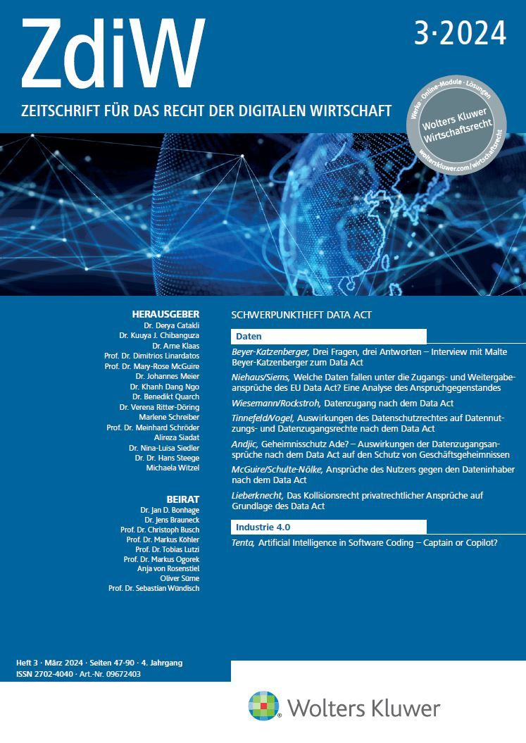
Further Reading
McGuire/Schulte-Nölke
Ansprüche des Nutzers gegen den Dateninhaber nach dem Data Act,
ZdiW 2024, S. 73-79.
Hartmann/McGuire/Schulte-Nölke
Datenzugang bei smarten Produkten nach dem Entwurf für ein Datengesetz (Data Act) – Rechtliche Rahmenbedingungen für die Vertragsgestaltung,
RDi 2023, S. 49-59.
McGuire/Schulte-Nölke
Smarte Maschinen & digitale Produkte: Auswirkungen der Umsetzung der Warenkauf-RL und Digitale-Inhalte-RL auf B2B-Verträge ,
ZdiW 2022, S. 397-403.
McGuire/Schulte-Nölke
Smarte Maschinen: Vertragsgestaltung & AGB-Kontrolle, ZdiW 2022, S. 437-441.
© Prof. Dr. Hans Schulte-Nölke · 26

Slide 27
Contact
Prof. Dr. Mary-Rose McGuire
Professur für Bürgerliches Recht,
Recht des Geistigen Eigentums,
deutsches und europäisches Zivilprozessrecht
Prof. Dr. Hans Schulte-Nölke
Professur für Bürgerliches Recht,
Europäisches Privat- und Wirtschaftsrecht,
Rechtsvergleichung und
Europäische Rechtsgeschichte
European Legal Studies Institute
www.elsi.uos.de
Freiburg, 06.12.2024

